Slide 1
“AI-Based Real-Time Flood Monitoring & Forecasting”
CSE7101- Capstone Project
Review-3
Batch Number:CAI_3
Under the Supervision of,
Dr.Mohammadi Akheela Khanum
Professor
School of Computer Science and Engineering
Presidency University
Roll Number | Name
20231CAI3009 | VANDAN GOWDA R
20221CAI0118 | VAISHNAVI SALUNKE
20221CAI0112 | ANUSHA H G
Name of the Program: B.Tech Computer Science & Engineering(Artificial Intelligence & Machine Learning)
Name of the HoD: Dr.Zafar Ali Khan N
Name of the Program Project Coordinator: Ms. Suma N G
Name of the School Project Coordinators: Dr. Sampath A K , Dr. Geetha A

Slide 2
Content
Problem Statement
Objectives
Background and Related work for title Selection
Analysis of Problem Statement
Innovation or Novel Contributions
Git-hub Link
Timeline of the Project
References

Slide 3
Problem Statement :
Organization:
Presidency university
Category(Software):
Software (AI, ML, Web Technology)
Problem Description:
This problem statement focuses on applying artificial intelligence or machine learning algorithms to automate tasks, enhance decision-making, and provide predictive analytics in fields such as public services, agriculture, health, or utilities.
There is a need for an ML-based system that integrates meteorological and hydrological data with machine learning models to provide real-time flood forecasting, early warning, and decision support for effective disaster management.

Slide 4
Objectives:
1.Develop a Machine-Learning Flood Predictor
Build and train a Random Forest model to estimate flood risk using weather and hydrology features.
2.Use Real-Time Weather Data
Integrate live meteorological information from the OpenWeatherMap API.
3.Provide a Web Monitoring Platform
Create a Flask-based dashboard and REST API to display and share risk levels.
4.Enable Continuous Monitoring
Support automated, 24/7 data polling for real-time alerts.
5.Design for Modularity and Expansion
Keep data ingestion, model inference, and presentation layers independent for easy future upgrades.

Slide 5
Background and Related work for title Selection:
Floods represent one of the most recurring and devastating natural disasters that humanity faces. They occur in almost every part of the world, ranging from urban flash floods to large-scale riverine inundations, and their impacts are felt across economic, social, and environmental dimensions. According to the United Nations Office for Disaster Risk Reduction (UNDRR), floods account for nearly 45% of all weather-related disasters worldwide. Over the past two decades, floods have affected more than 2.3 billion people, caused the loss of over 157,000 lives, and inflicted trillions of dollars in economic damage. In India, floods are a seasonal phenomenon during the monsoon, yet their severity is increasing year after year. Reports from the Central Water Commission (CWC) indicate that nearly 12% of India’s land area is flood-prone, and the average annual loss due to floods is estimated to be more than ₹6,000 crores (≈750 million USD). These alarming statistics demonstrate that effective flood risk management is not a luxury but a necessity for safeguarding human lives and infrastructure.

Slide 6
Analysis of Problem Statement:
Floods remain one of the most destructive natural disasters, and current systems have several gaps. The problem can be analyzed as follows:
Lack of reliable real-time flood monitoring systems for continuous observation.
Existing models focus mainly on forecasting but fail to provide live situational updates.
Delayed data availability – Meteorological and hydrological data updates are too slow for dynamic flood conditions.
High infrastructure cost – IoT and sensor-based solutions require expensive hardware and maintenance.
Regional limitations – Hydrological models need calibration for specific regions, reducing scalability.
Limited accessibility – Existing tools often present data in complex formats that are not usable by communities or local authorities.
Floods account for 44% of all weather-related disasters worldwide [1].
More than 1.6 billion people were affected globally between 2000–2019 [1].
In India, 12% of landmass is flood-prone, causing annual damages of over ₹6,000 crores (~750M USD) [2].
Effective monitoring can reduce casualties, economic losses, and improve disaster response.

Slide 7
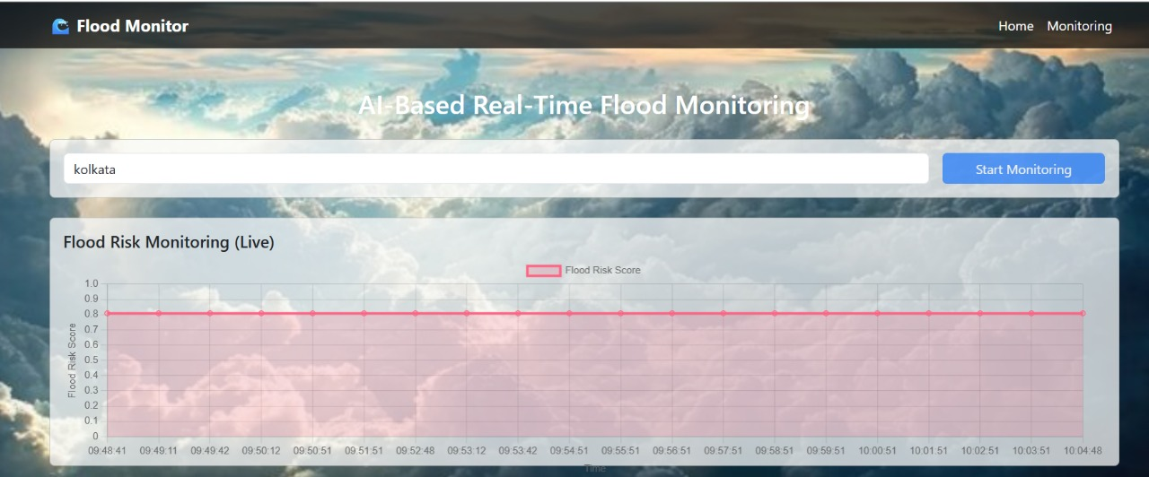
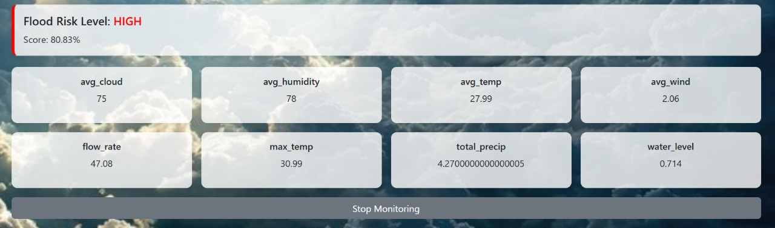
Innovation or Novel Contributions:

Slide 8
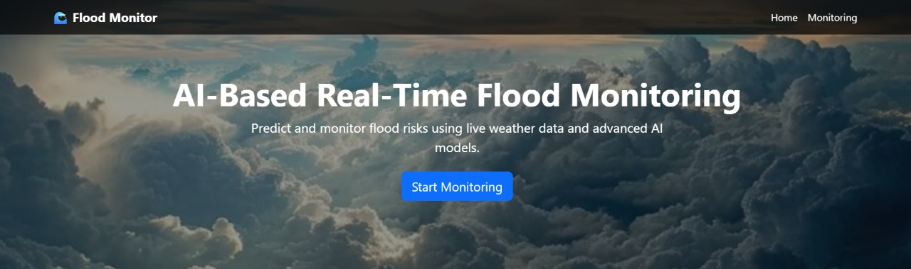
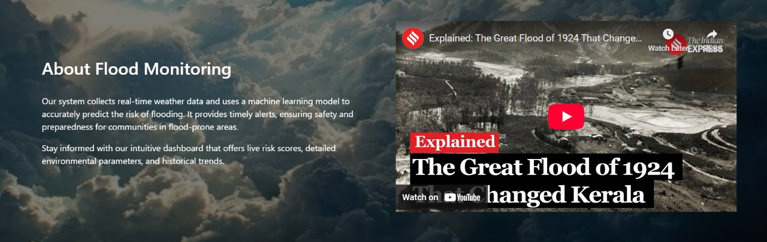
Innovation or Novel Contributions:

Slide 9
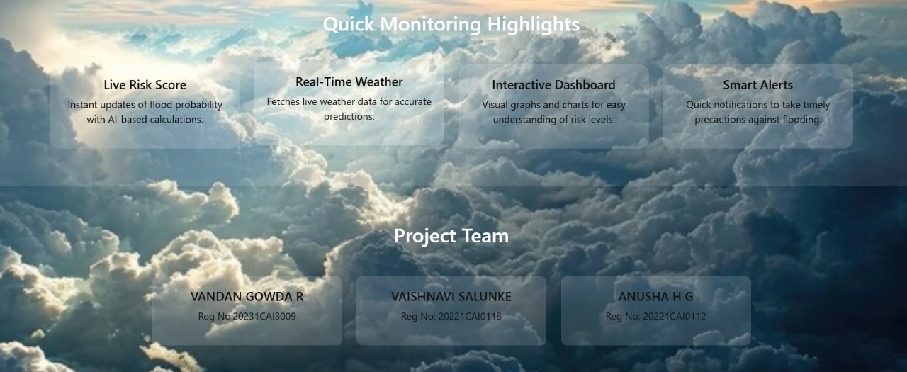
Innovation or Novel Contributions:

Slide 10
Github Link:
Github Link
https://github.com/VandanGowdaR/AI-Based-Real-Time-Flood-Monitoring.git

Slide 11
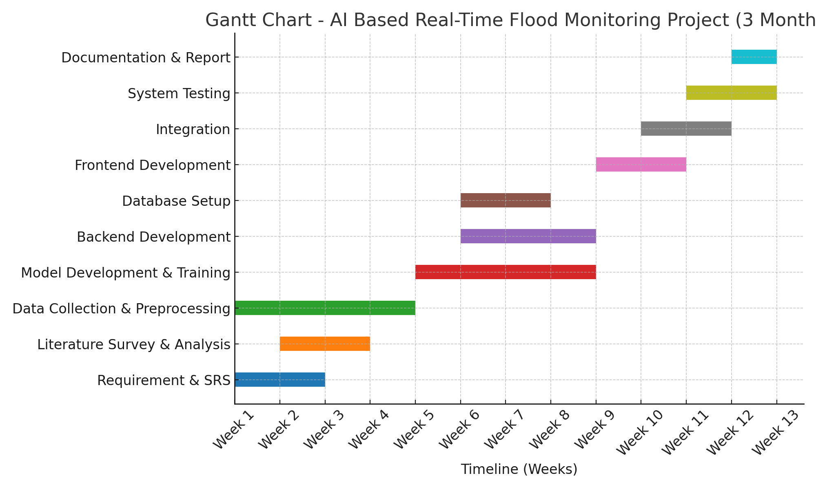
Timeline of the Project (Gantt Chart):

Slide 12
References (IEEE Paper format):
[1] G. Nearing, D. Cohen, V. Dube, et al., “Global prediction of extreme floods in ungauged watersheds,” Nature, vol. 627, pp. 559–563, 2024.
[2] J. Li, G. Wu, Y. Zhang, and W. Shi, “Optimizing flood predictions by integrating LSTM,” Heliyon, vol. 10, no. 13, 2024.
[3] H. Wahba, A. El Afandi, and M. Almazroui, “Flash-flood susceptibility mapping using Random Forest,” Heliyon, vol. 10, no. 13, 2024.
[4] H. Wahba, A. El Afandi, and M. Almazroui, “Minimalist data-driven hydrology with machine learning components,” Heliyon, 2024.
[5] A. Rajab, H. Farman, N. Islam, D. Syed, and M. A. Elmagzoub, “Flood forecasting with machine learning: a study leveraging historic climatic records of Bangladesh,” Water, vol. 15, no. 22, p. 3970, 2023.

Slide 13
References (IEEE Paper format):
[6] H. Wahba, A. El Afandi, and M. Almazroui, “Flash-flood susceptibility mapping using Random Forest with spatial predictors,” Heliyon, 2024.
[7] C. Albertini, A. Gioia, V. Iacobellis, G. P. Petropoulos, and S. Manfreda, “Multi-source Random Forest classification of floods: assessing robustness of predictor variables in flooded areas,” Remote Sensing Applications: Society and Environment, vol. 35, p. 101239, 2024.
[8] X. Tang, L. Zhang, and Y. Chen, “Flood forecasting based on machine learning patterns for extreme flood events,” Journal of Hydrology, 2023.
[9] X. Tang, L. Zhang, and Y. Chen, “Ensemble machine learning models for classifying extreme flood risk,” Journal of Hydrology, 2023.
[10] F. Hirpa, P. Salamon, H. Beck, V. Lorini, L. Alfieri, E. Zsoter, and S. Dadson, “Calibration of the Global Flood Awareness System (GloFAS) using daily streamflow data,” Journal of Hydrology, vol. 566, pp. 595–606, 2018.

Slide 14


